Slide 1


Prognosi e
risposta terapeutica
Roberto Bianco
robianco@unina.it

Slide 2
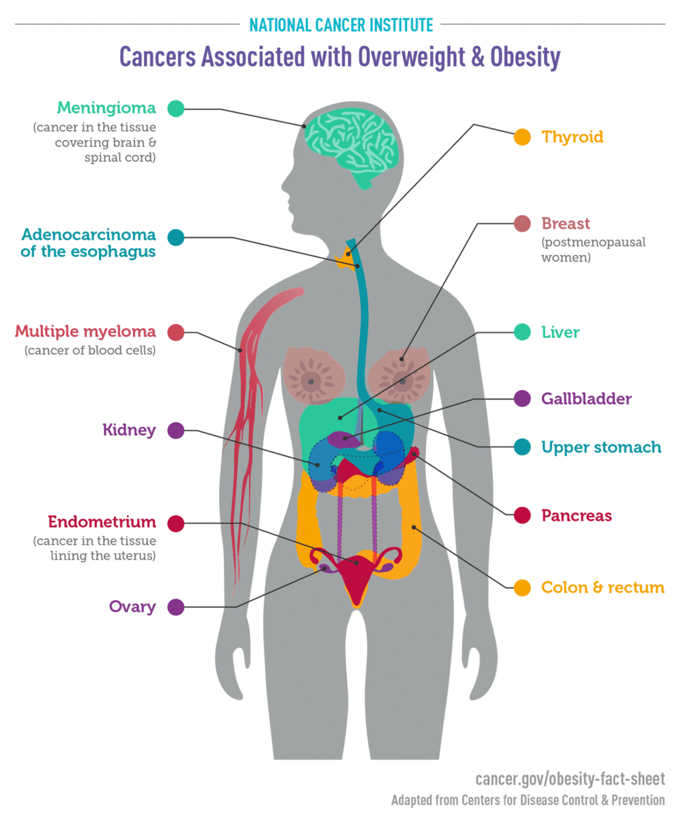

Slide 3
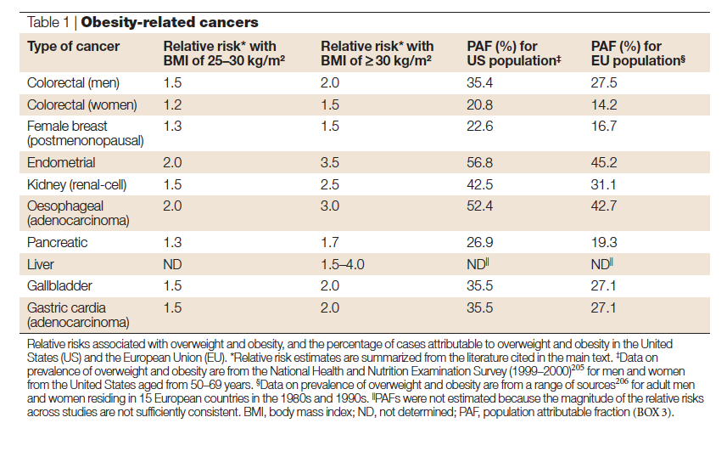

Slide 4
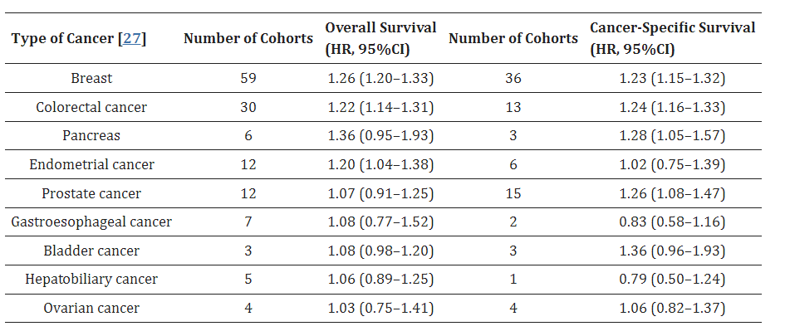
Relationship between obesity and overall survival and cancer-specific survival

Slide 5
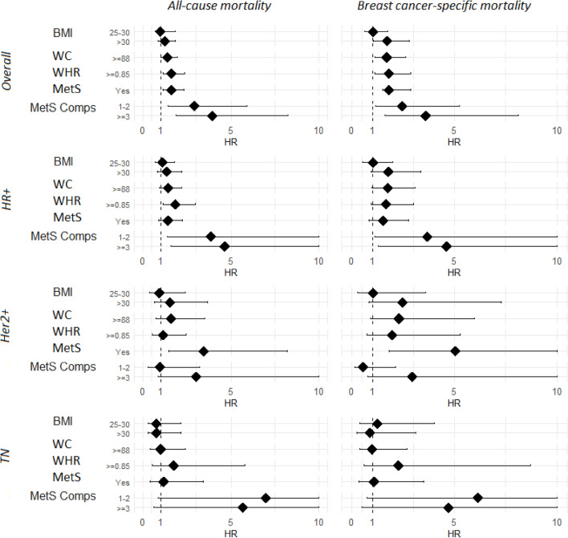
Obesity increases mortality of breast cancer in the Campania Region
A significant increased risk of BC-specific mortality was found in obese patients
Central obesity significantly increased total and BC-specific mortality particularly in pre-menopausal women and in luminal subtypes, while in post-menopause MetS was a stronger risk factor.
Obesity and MetS may impair the effectiveness of BC therapies hence active lifestyle interventions are encouraged.
Crispo A, Sci Rep 2023
Notes:
Obesity (BMI≥30 kg/m²) was found in 29% of the whole study cohort

Slide 6
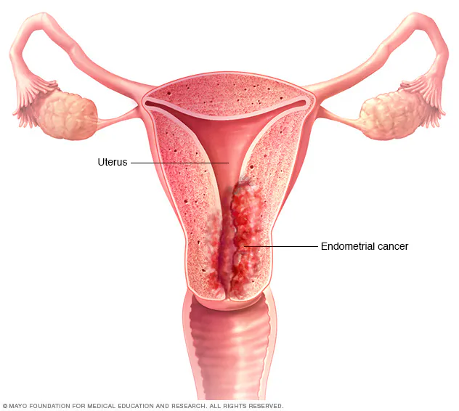
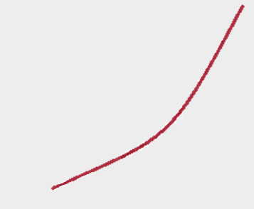
Obesity and endometrial cancer
More than 40% of endometrial cancers can be attributed to overweight and obesity
M. Rota et al, BJOG 2015
Endometrial cancer was the
first tumour to be identified as obesity-related
Each 5 kg/m2 increase in BMI is associated with a
62% increase in endometrial cancer
3
2
HR
(CI 99%)
P< 0.0001
1.62 (1.56-1.69)
P-value < 0.0001
1
0
0
20
30
0.7
1
1.3
1.6
1.9
Estimated Hazard Ratio per 5kg/m2 in BMI (99% CI)
BMI (Kg/m2)
K Bhaskaran et al, Lancet 2014

Slide 7

Prognosis of Endometrial cancer in obese patients
Significant positive linear trend in death rate for endometrial cancer with increasing
BMI
RR
30 – 34.9 2.53 (95% CI 2.02 – 3.18)
35 – 39.9 2.77 (95% CI 1.83 – 4.18)
> 40 6.25 (95% CI 3.75 – 10.42)
Calle EE et al, NEJM 2003
Papatla et al, Annals of Oncoloy 2016
OBESE WOMEN, as compared to non obese, have POORER OUTCOMES
in terms of:
All cause mortality (HR 1.85 95% CI 1.19 – 2.88)
Endometrial cancer specific mortality (HR 2.23 95% CI 1.09 - 4.54)
Arem et al, Gynecol Oncol 2013
Notes:
all-cause mortality hazard ratio (HR) = 1.85 (95% CI 1.19-2.88) comparing women with a BMI ≥ 35 kg/m(2) to women with BMI< 25 kg/m(2). For endometrial cancer-specific mortality the HR = 2.23 (95% CI 1.09-4.54) comparing extreme BMI categories

Slide 8
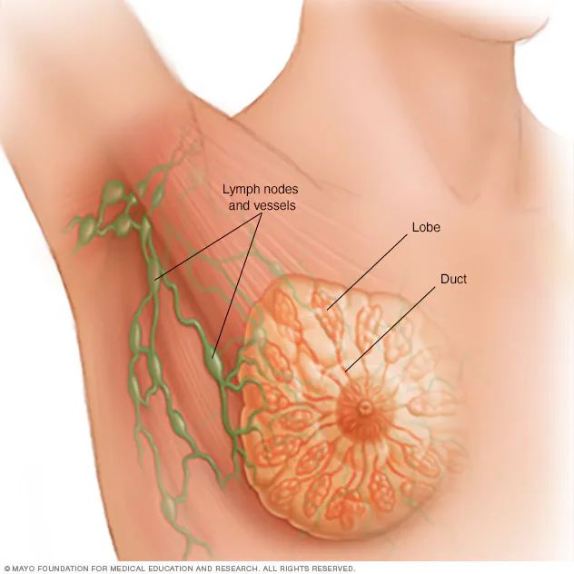
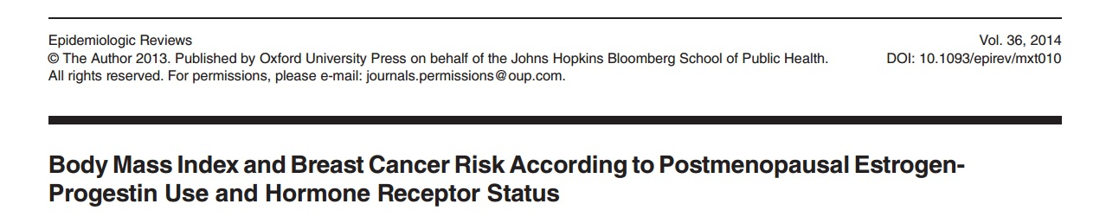
Obesity and Breast Cancer
OBESITY is considered a RISK FACTOR for POSTMENOPAUSAL BREAST CANCER, whereas it seems to be neutral or even inversely related to the incidence of breast cancer in premenopausal women
ER-positive subtypes occur more often among postmenopausal women
OBESITY is significantly ASSOCIATED WITH receptor positive postmenopausal breast cancer - Summary Risk Ratio of 1.39 (95% CI: 1.14- 1.70) - BUT NOT with ER-negative/PR-negative cancer
Meta-analysis of 89 epidemiologic reports

Slide 9
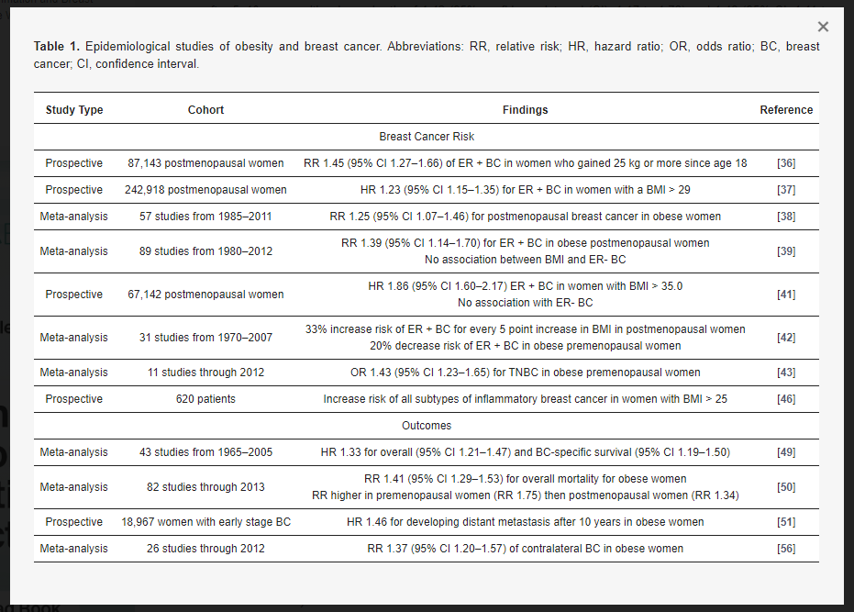
Empidemiological studies of obesity and breast cancer

Slide 10
Prognosis of breast cancer in obese patients
OBESE WOMEN, as compared to non obese, have POORER OUTCOMES
in terms of:
recurrence free survival (HR 1.24; 1.04- 1.48)
overall mortality (HR 1.33; 1.21- 1.47)
breast cancer specific mortality (HR 1.33; 1.19- 1.50)
M Protani et al, Breast Cancer Res Treat 2010; S Jiralerspong et al, Ann of Oncol 2013

Slide 11
Obesity and poorer breast cancer prognosis
POSSIBLE EXPLANATIONS
Delayed diagnosis
Patients with a BMI> 30 kg/m2 have more advanced disease at diagnosis
compared to patients with a BMI <25 kg/m2
Lower response to and/or higher toxicity of cancer treatments
Higher BMI is associated with lower pathologic complete response to
neoadjuvant chemotherapy
Higher BMI is associated with an increased Trastuzumab and anthracyclines- induced cardiotoxicity
Chemo and endocrine therapies not adjusted to BMI
Guenancia et al, 2016; Karatas et al, The Breast 2016; C Benedetto et al, Best Pract Res Clin Obstet Gynaecol 2015; MC Pladyon et al, JNCI 2015

Slide 12
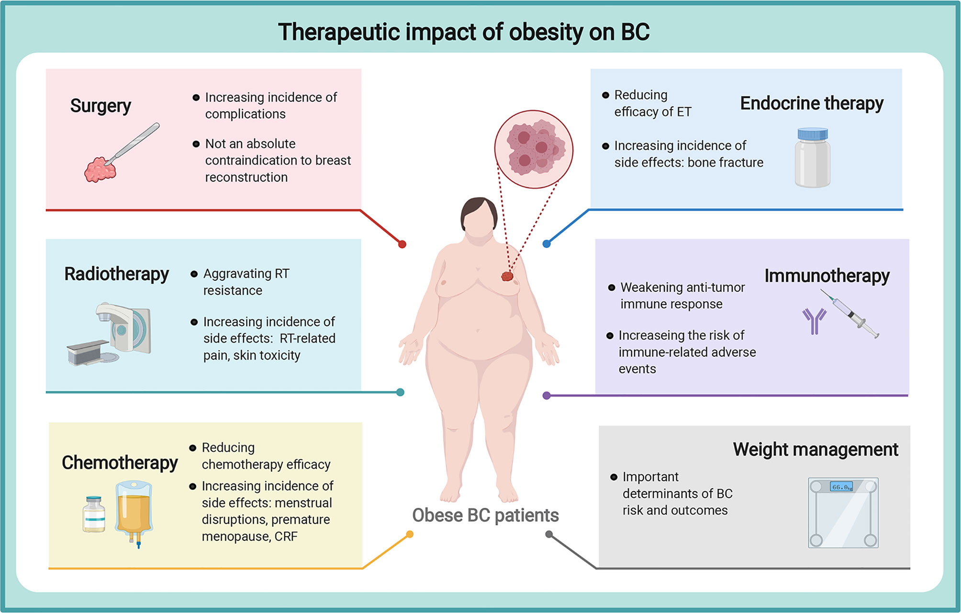

Slide 13
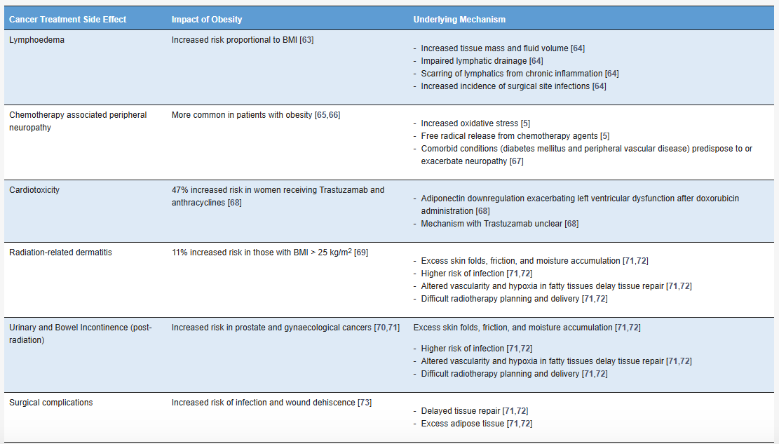
The impact of obesity in relation to cancer treatment-related side effects

Slide 14
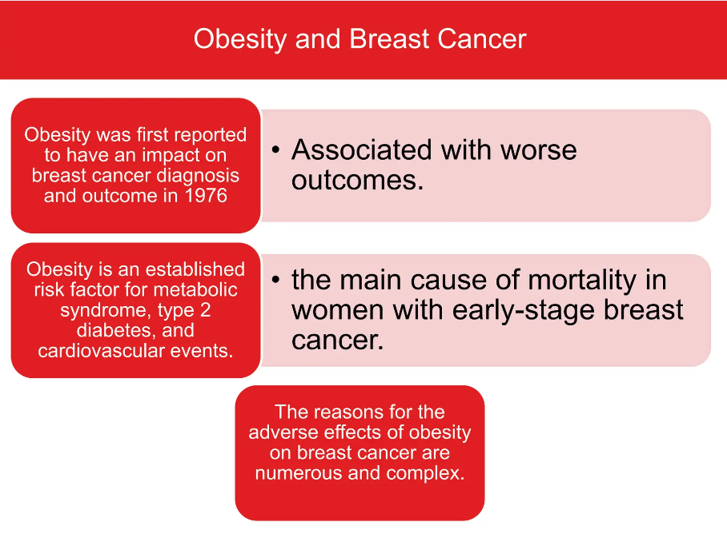

Slide 15
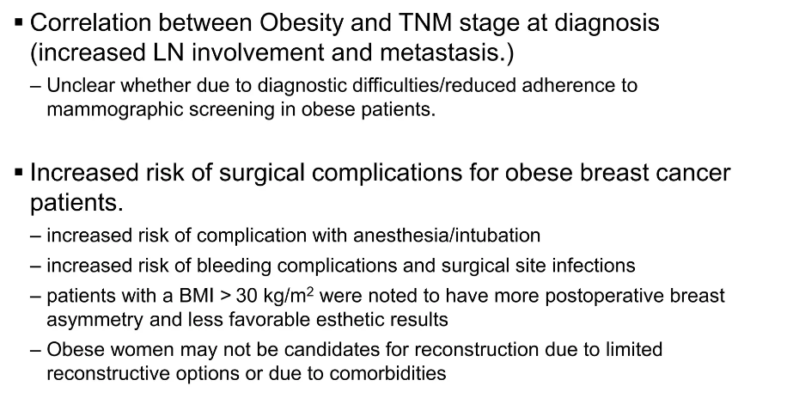
Effects on screeing, diagnosis and treatment

Slide 16
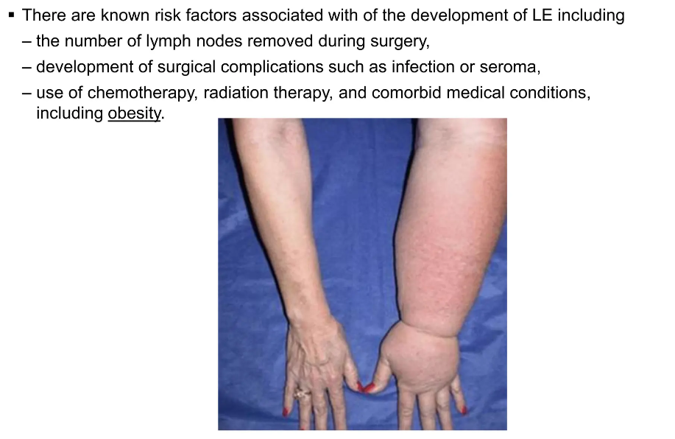
Lymphedema risk

Slide 17
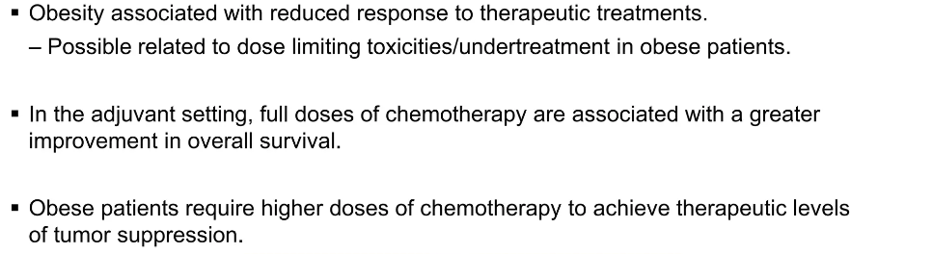
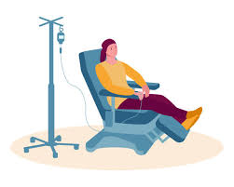
Barriers to chemotherapy

Slide 18
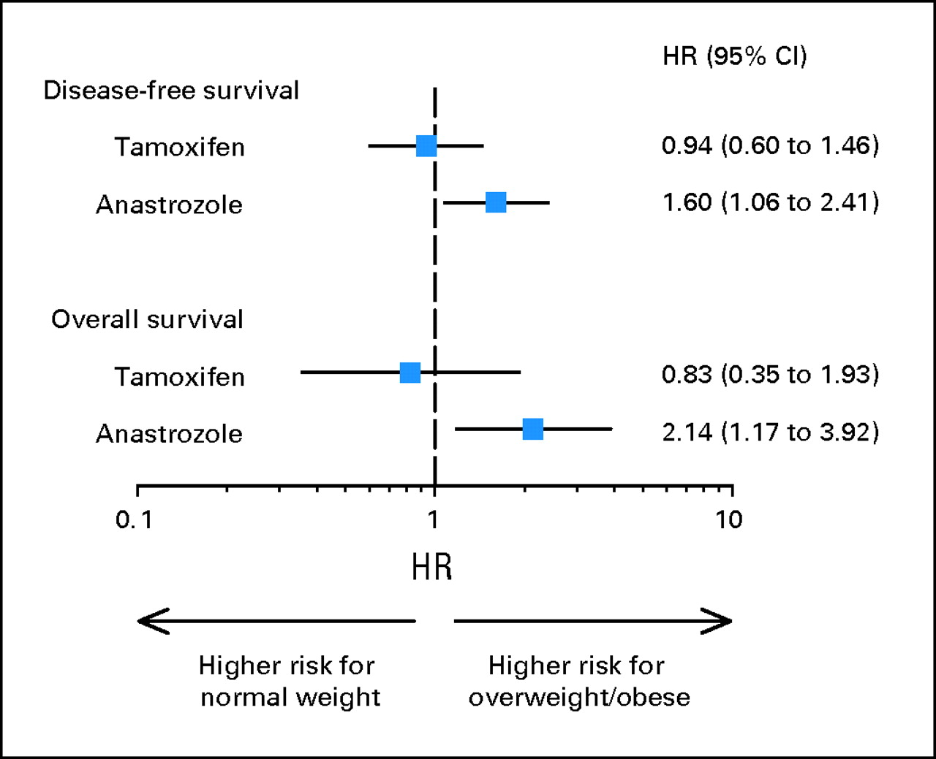
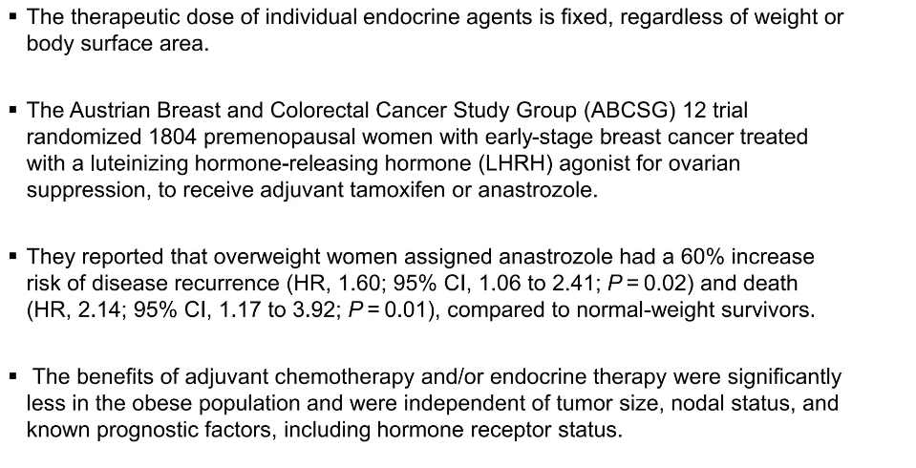
Endocrine therapy

Slide 19
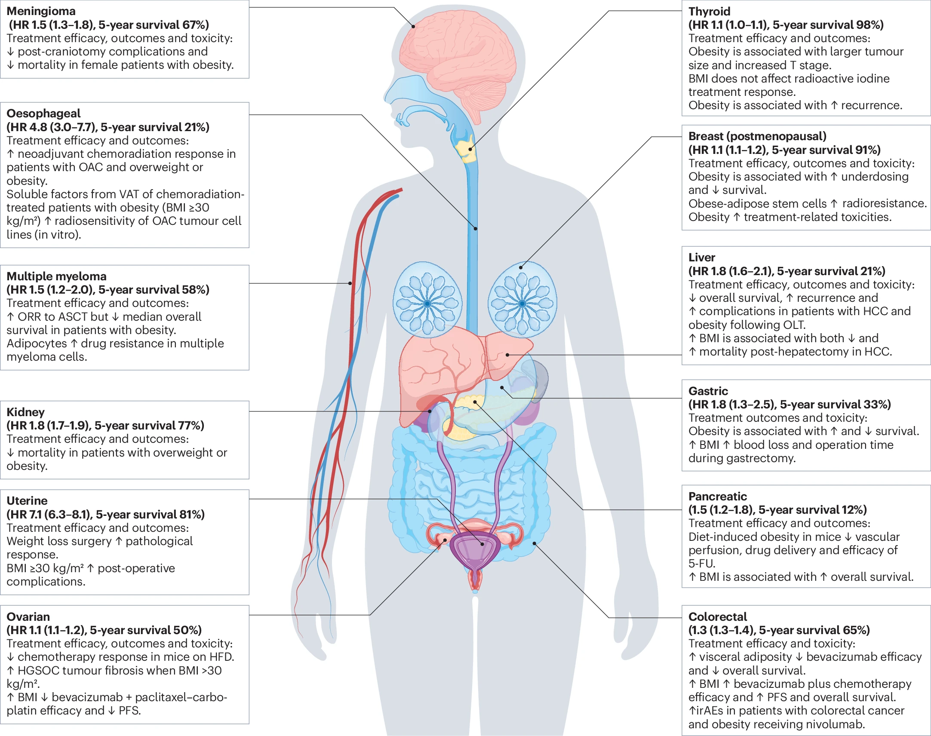
The multifactorial effect of obesity on the effectiveness and outcomes of cancer therapies

Slide 20
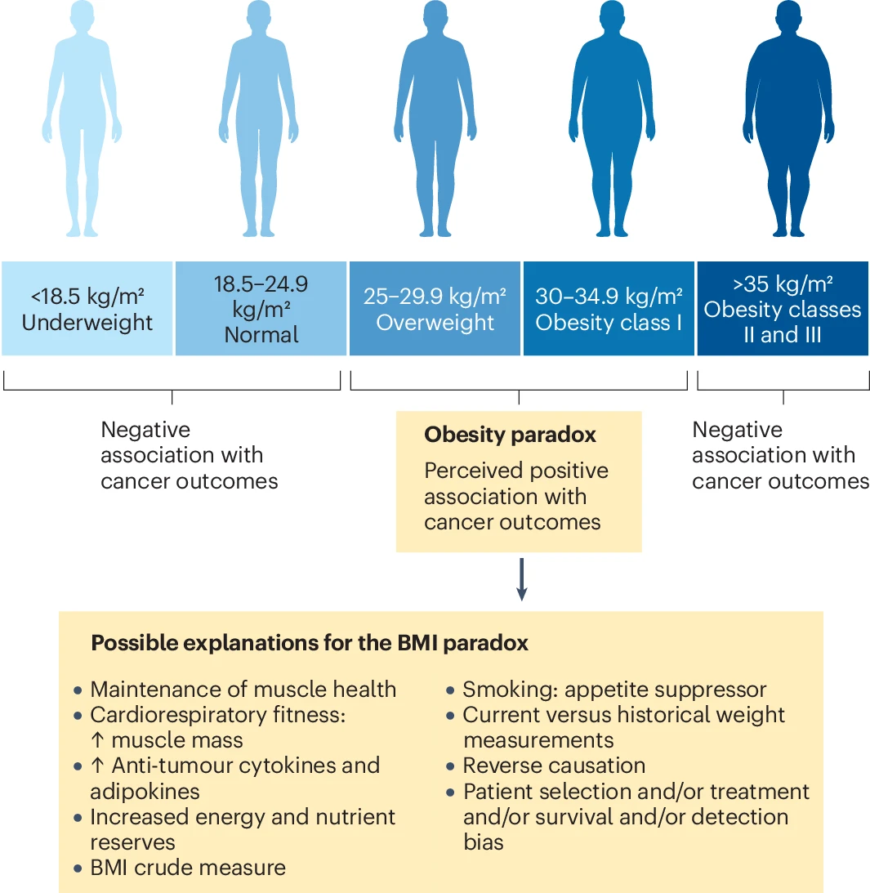
Notes:
The ‘obesity paradox’ has been reported in patients with cancer with a BMI in the range 25–35 kg/m². Potential explanations for the obesity paradox, sometimes reframed as the ‘BMI paradox’, include the use of BMI itself as the measure, as BMI does not factor in the extent or physiological distribution of adipose tissue, or the contribution of muscle mass or bone density to overall weight; it also does not account for differences in race, sex, ethnicity or age. The patient’s previous maximum BMI might be a more accurate measure of baseline BMI prior to cancer development and the effect of cancer treatment on body weight than the current BMI. People who smoke tend to have a lower BMI than people who do not smoke, as smoking is an appetite suppressant. Bias exists in cohort selection when comparing treatment and survival outcomes by using studies that did not set out to examine the effect of BMI on cancer outcomes. Reverse causation is also an important consideration in some instances, such as in sarcopenic obesity, where muscle loss caused by the developing tumour before clinical presentation can affect subsequent patient outcomes, which would confound an association with BMI. Body composition and muscle mass, in particular, are altered due to physical activity and improved cardiorespiratory fitness. BMI in the range 25–35 kg/m² could also reflect better nutritional status and muscle reserves. Adipokines and cytokines produced in expanded white adipose tissue and released into the circulation can also have an antitumour effect.

Slide 21
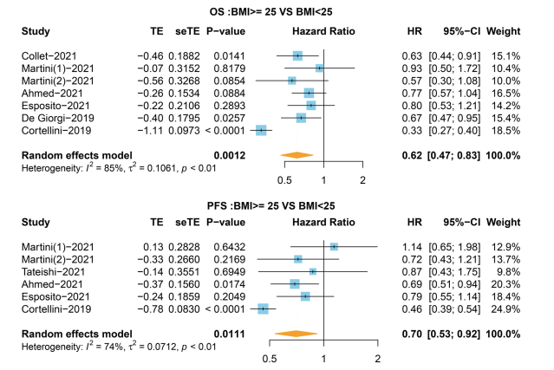
Association between BMI (<25 and ≥25 kg/m2 groups) and survival in patients with cancer receiving immunotherapy
The obesity paradox
Guo et al, Mol Clin Onco 2024

Slide 22
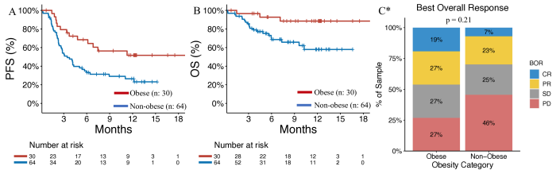
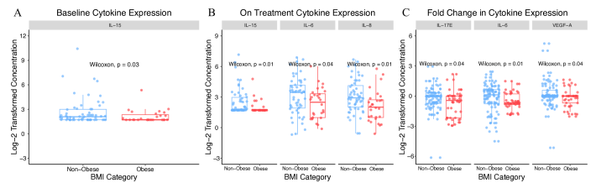
The obesity paradox in cancer patients treated with immunotherapy
Alden SL, et al. J Immunother Cancer 2025;13:e009734. doi:10.1136/jitc-2024-009734
Notes:
Obese and non-obese patients with cancer have divergent immunological responses to ICIs. Obesity is associated with reduced levels of certain inhibitory cytokines and higher expression of T-cell exhaustion markers. ICI-based therapy may more effectively reverse T-cell dysfunction in obese patients, potentially contributing to the paradoxically improved responses in this population.

Slide 23
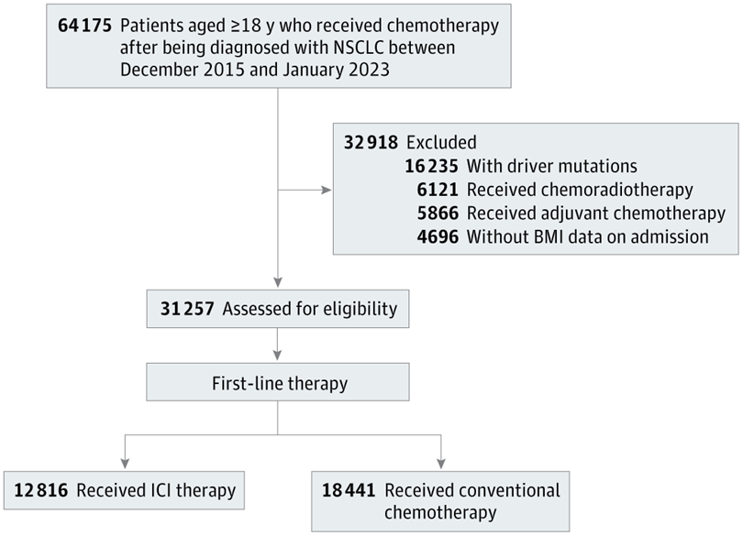
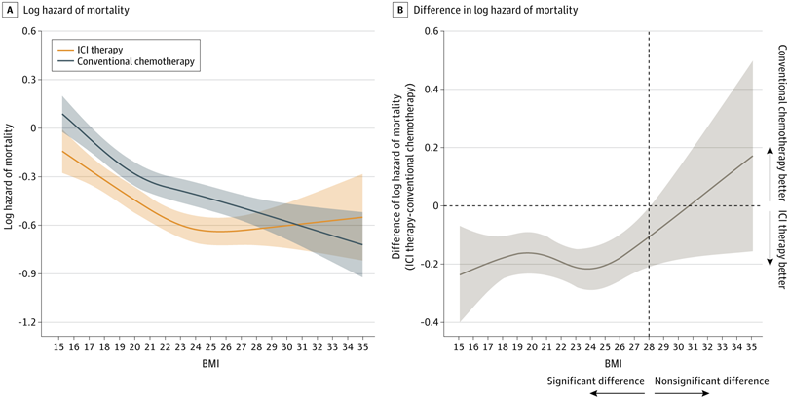
Immunotherapy and Overall Survival Among Patients With Advanced Non–Small Cell Lung Cancer and Obesity
Ihara Y et al, JAMA 2024
Notes:
The findings of this retrospective cohort study suggest that BMI modifies the association of ICI therapy compared with conventional chemotherapy with overall survival in patients with aNSCLC. A lack of association between ICI therapy and improved survival in patients with aNSCLC and overweight or obesity compared with conventional chemotherapy was observed. This suggests that ICI therapy may not be the optimal first-line therapy for patients with overweight or obesity and the use of conventional chemotherapy should also be considered in such patients.

Slide 24
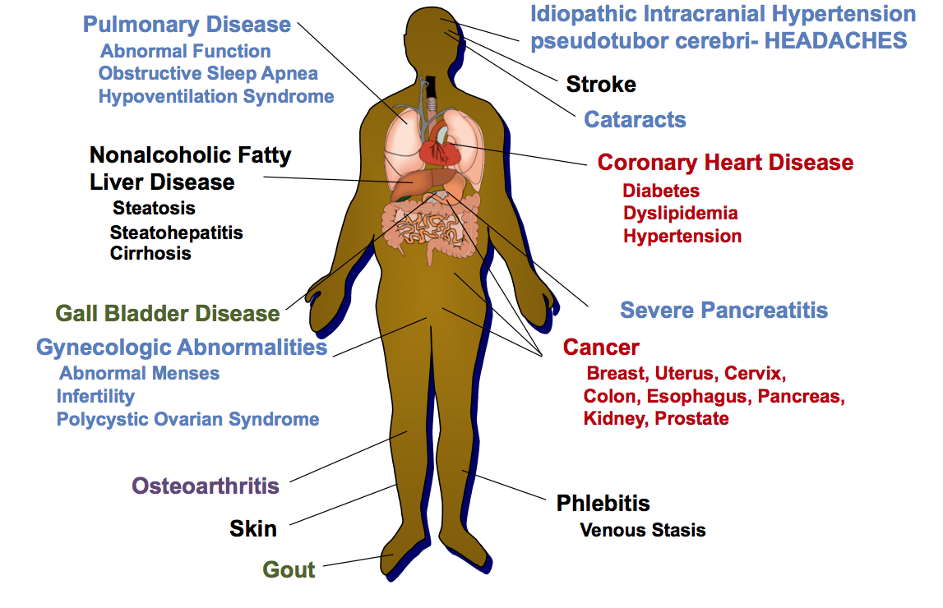
Obesity related complications and the
managment of cancer patients

Slide 25

Therapy: Don’t wait, Don’t hesitate
Cancer diagnosis is an opportunity for behavior change
Support systems are active
Consequences (risk vs benefit) are high
Engage healthcare team
Small changes can translate to significant improvements in health indices and greater health and well-being

Slide 26
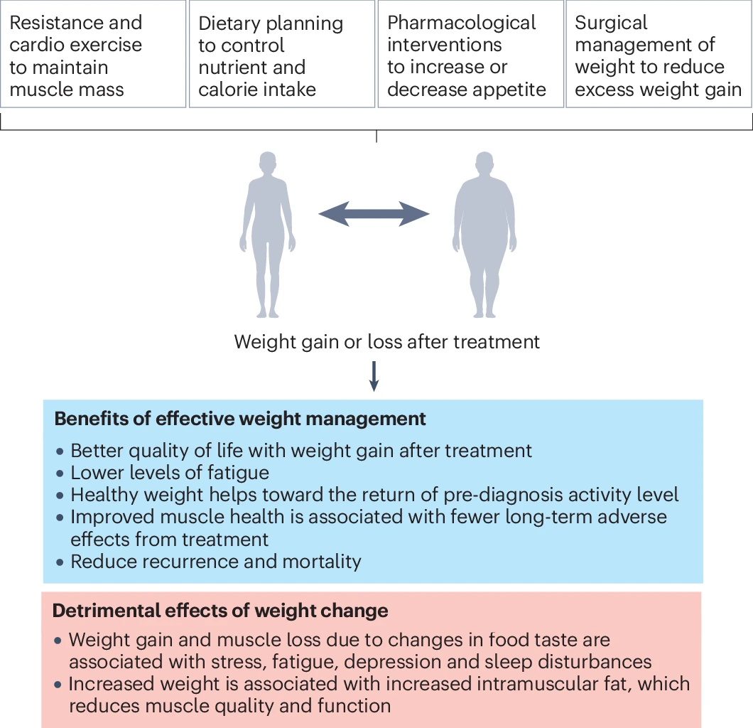
Weight management after cancer treatment

